Slide 1


Breast Cancer Prediction: A Machine Learning Approach
This presentation explores the use of machine learning techniques to predict breast cancer, potentially saving lives and empowering individuals with early detection.
AS
by Abhishek Singh

Slide 2
Data Preprocessing with NumPy and Pandas
NumPy
Pandas
Preprocessing Steps
NumPy provides efficient array operations and mathematical functions for data manipulation.
Pandas offers powerful data structures like DataFrames for loading, cleaning, and exploring datasets.
Data Cleaning
Feature Engineering
Data Transformation

Slide 3
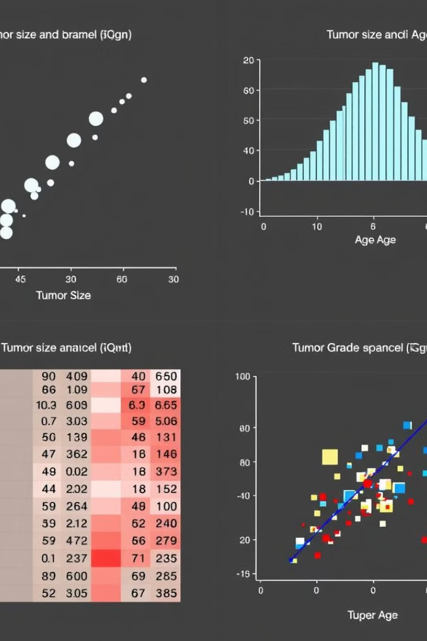
Exploratory Data Analysis with Matplotlib and Seaborn
1
Visualizations
2
Feature Analysis
Matplotlib and Seaborn libraries create insightful visualizations.
Understanding relationships between features and their impact on cancer prediction.
3
Data Distribution
4
Insights
Analyzing patterns in the data to identify potential correlations and outliers.
Gaining valuable insights into the data to inform model development.

Slide 4
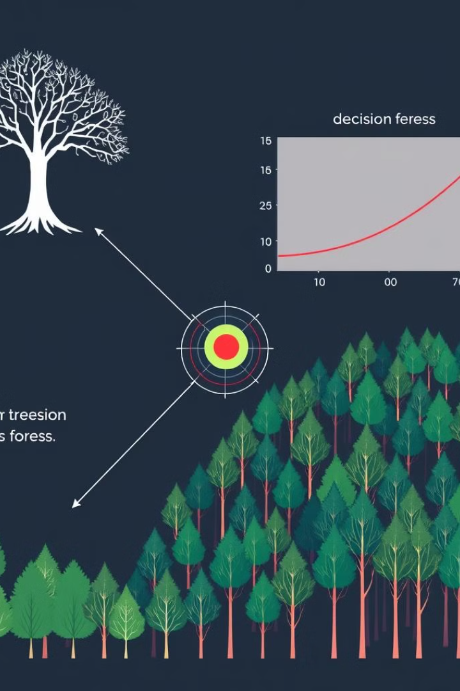
Machine Learning Algorithms: Logistic Regression, Decision Tree, and Random Forest
Logistic Regression
Decision Tree
A linear model that predicts the probability of belonging to a specific class, suitable for binary classification.
A tree-based model that makes decisions based on splitting data points at specific thresholds.
Random Forest
An ensemble method that combines multiple decision trees to improve prediction accuracy and reduce overfitting.

Slide 5
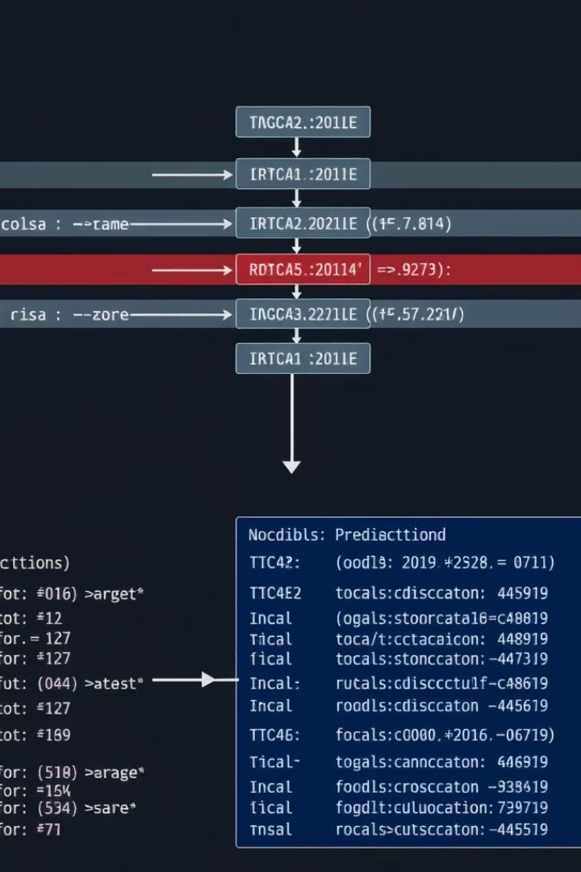



Model Training, Evaluation, and Optimization using Scikit-learn
Training
Fit the chosen algorithm to the data.
Evaluation
Assess model performance using metrics like accuracy, precision, and recall.
Optimization
Fine-tune hyperparameters to enhance model performance.

Slide 6

Deployment and Conclusion: Saving Lives through Breast Cancer Prediction
Model Deployment
Using Joblib to save and load trained models for efficient use.
Impact
Early detection and timely interventions can significantly improve outcomes.
Future Work
Exploring advanced techniques and integrating with clinical workflows for broader implementation.

